Slide 1
NASA Benchmark Models:
Angle of attack effects

Slide 2
NACA 0012 CFD results
Results show clear trends in stability with angle of attack.
Working on skin friction and pressure coefficient plots as functions of AOA.

Slide 3
Benchmark Supercritical Wing
AePW-1: BSCW analysis at Mach 0.85, AoA = 5deg
AePW-2: BSCW analysis at
  Mach 0.7, AoA = 3 deg
  Mach 0.74, AoA = 0 deg
  Mach 0.85, AoA = 5deg
Current FUN3D BSCW analysis at Mach 0.80 and AoA = 5deg

Slide 4
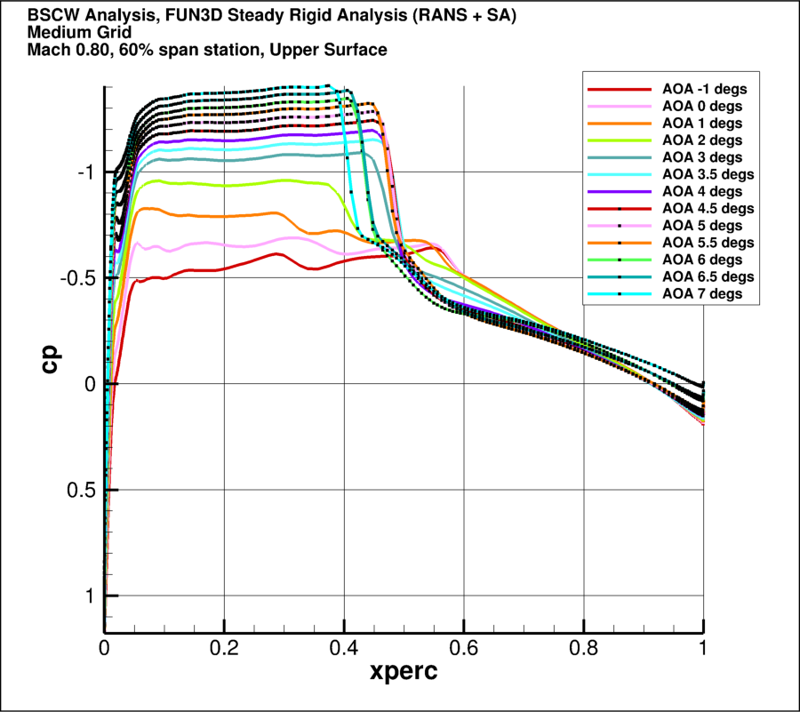
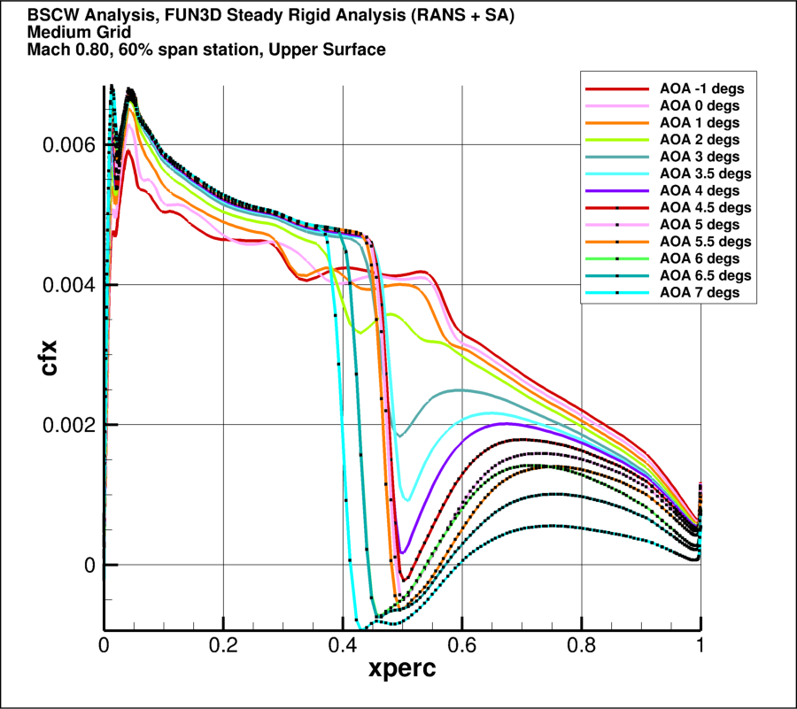
Mach 0.80
Medium Grid RANS+SA Analysis: 60% span station
At this span station, separation is indicated at 4.5 degs and above based on skin friction coefficient < 0 and reversal of shock travel (i.e., the shock position moves aft with increasing angle of attack until separation onset. Beyond this angle of attack, further increases in angle of attack result in the shock moving forward.)

Slide 5
Benchmark SuperCritical Wing (BSCW) Study, Mach 0.8, AoA = 5deg

Slide 6
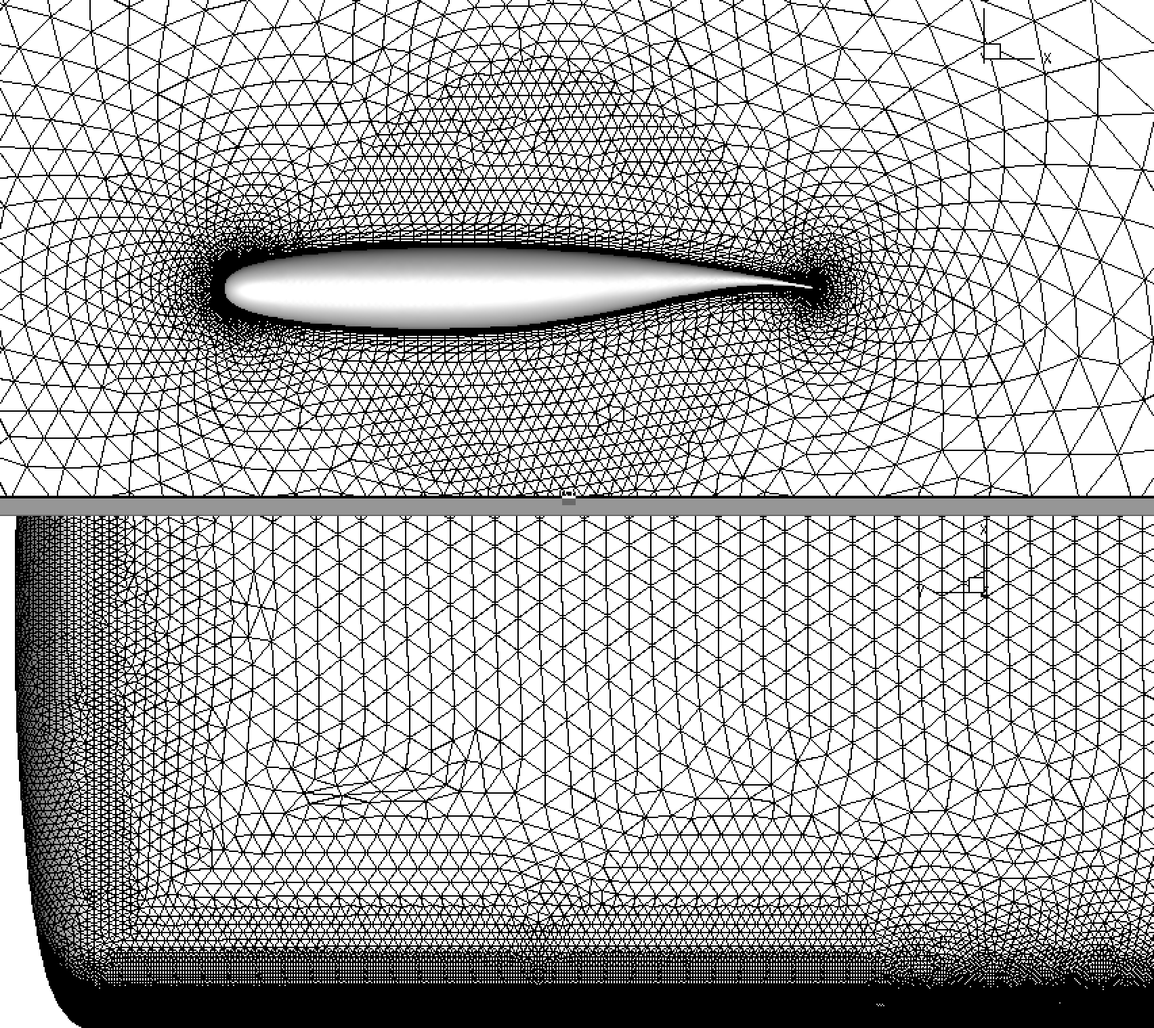
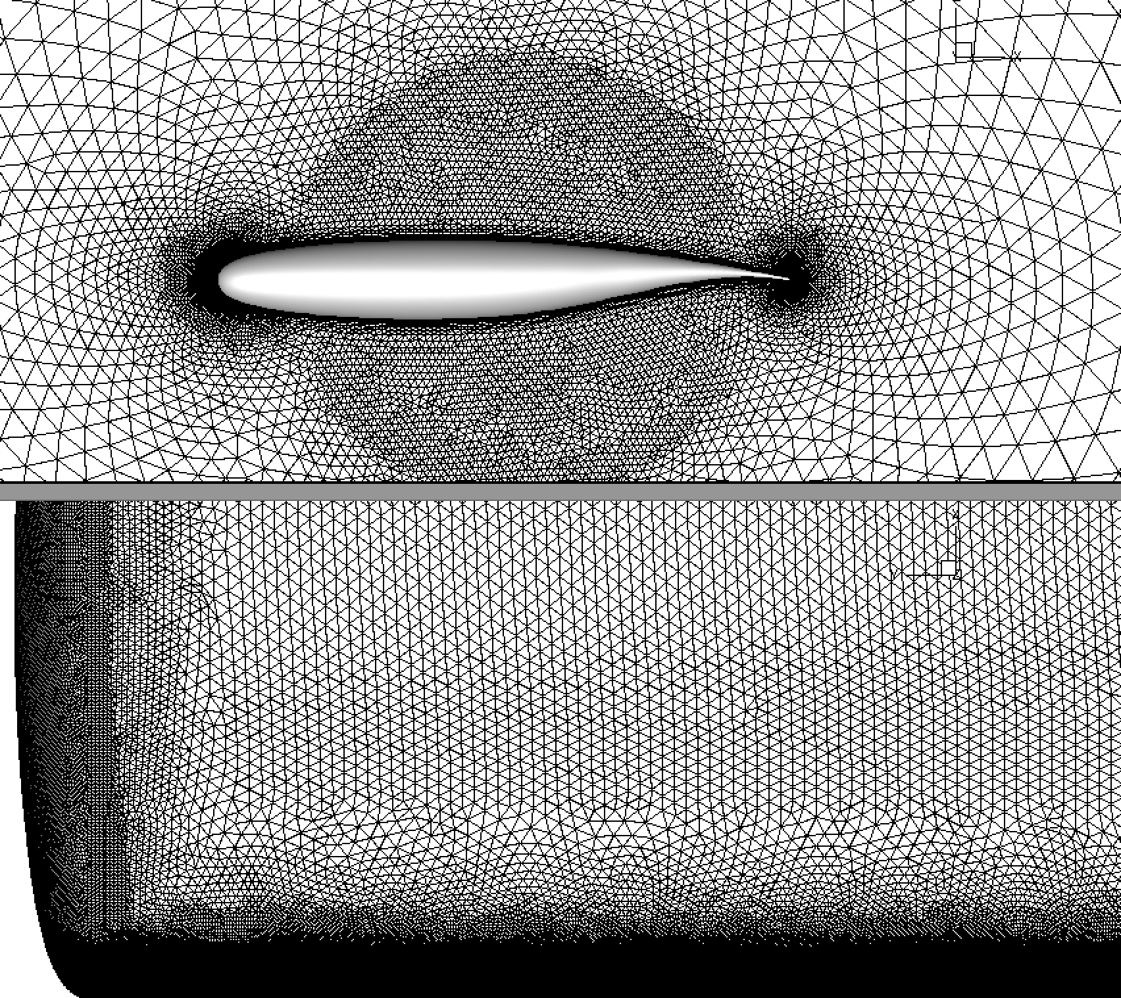
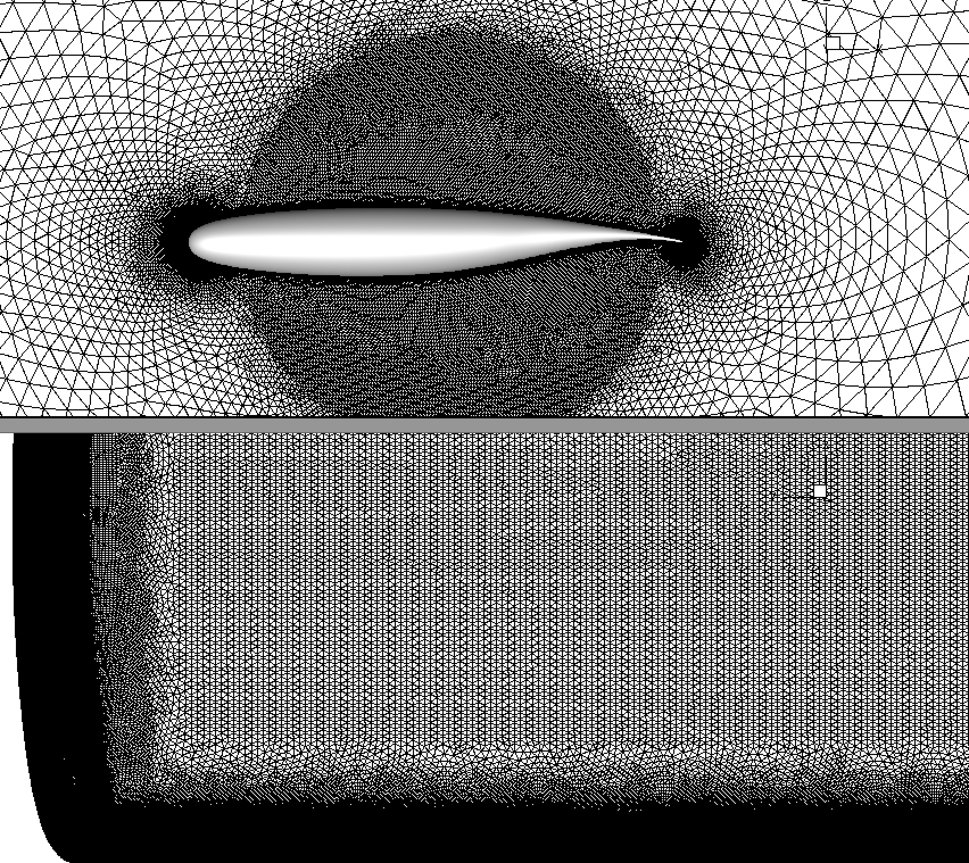
FUN3D BSCW analysis at Mach 0.80 and AoA = 5deg, SA turbulence model
AePW Coarse (3M)
AePW Medium (9M)
AePW Fine (27M)

Slide 7
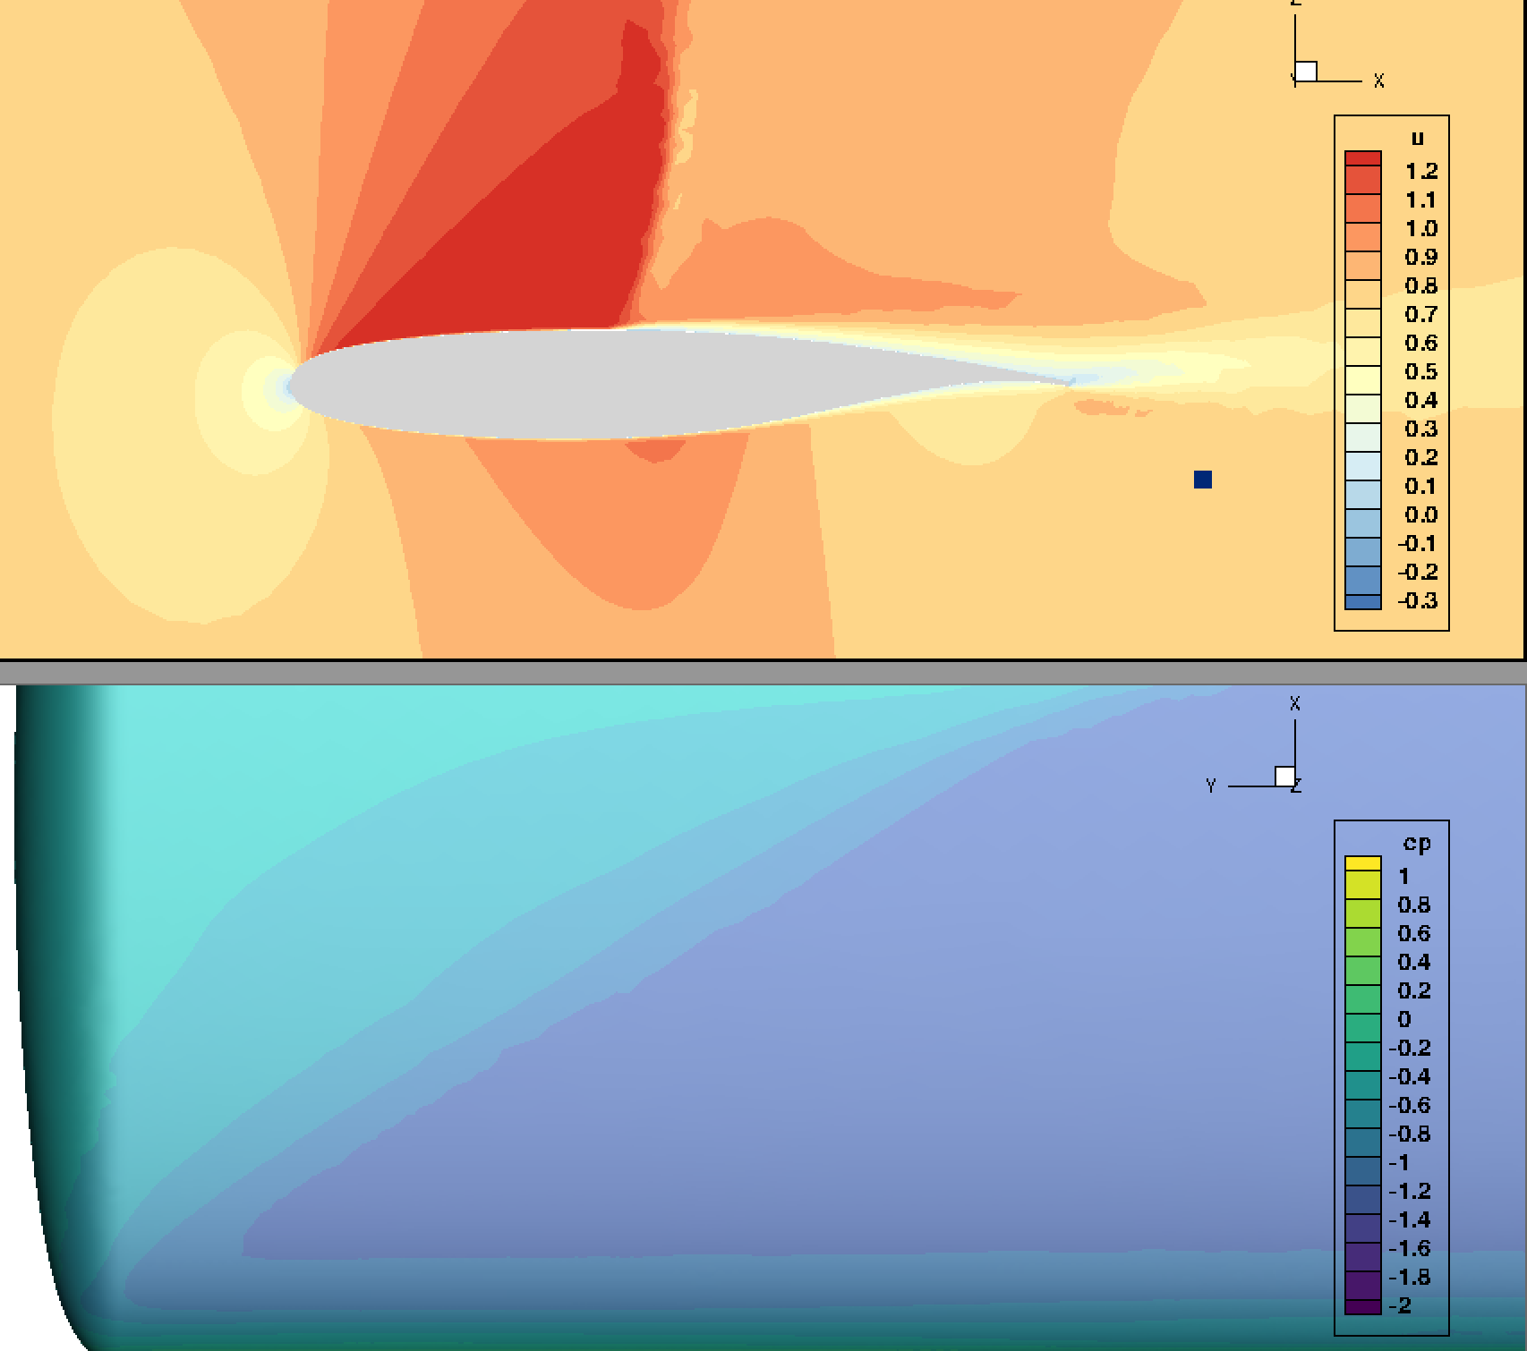
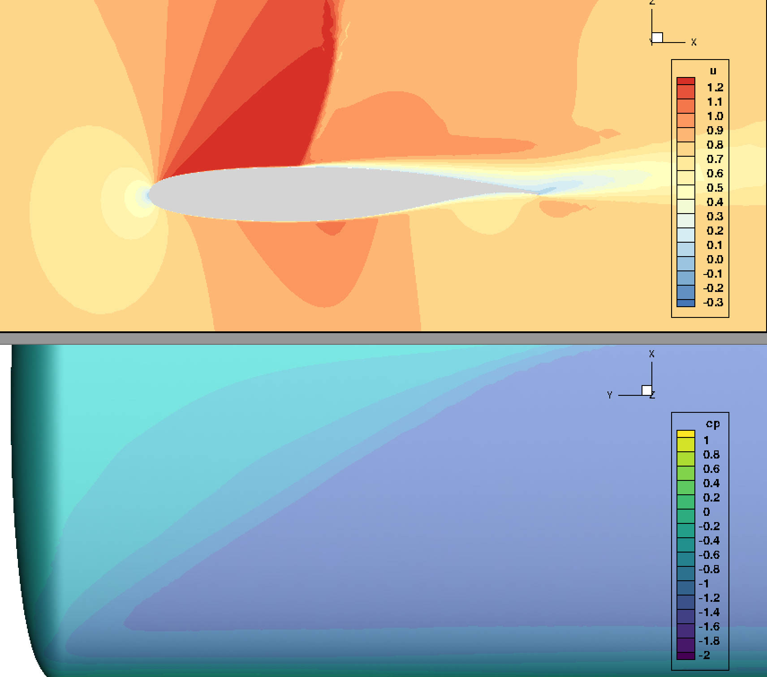

FUN3D BSCW analysis at Mach 0.80 and AoA = 5deg, SA turbulence model, no limiter
AePW Coarse (3M)
AePW Medium (9M)
AePW Fine (27M)

Slide 8
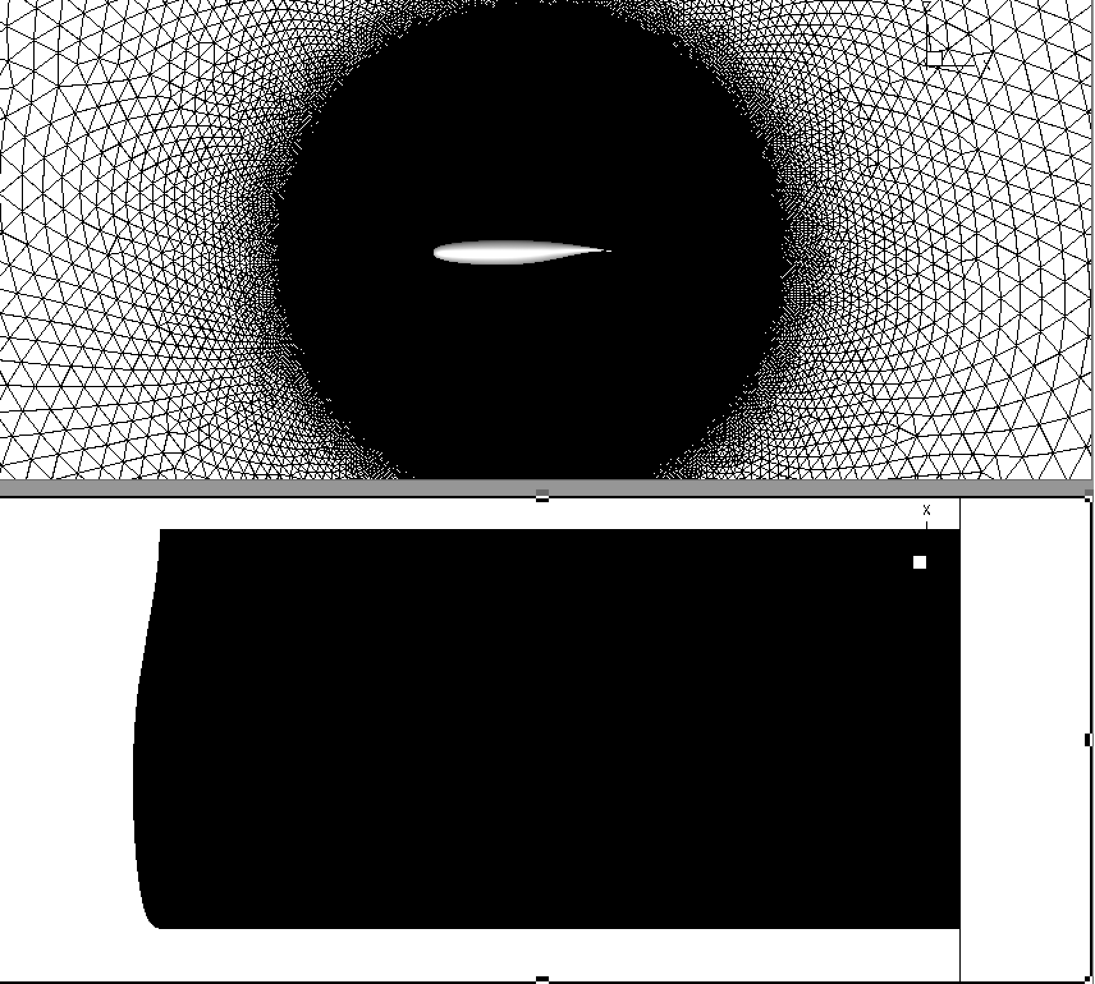
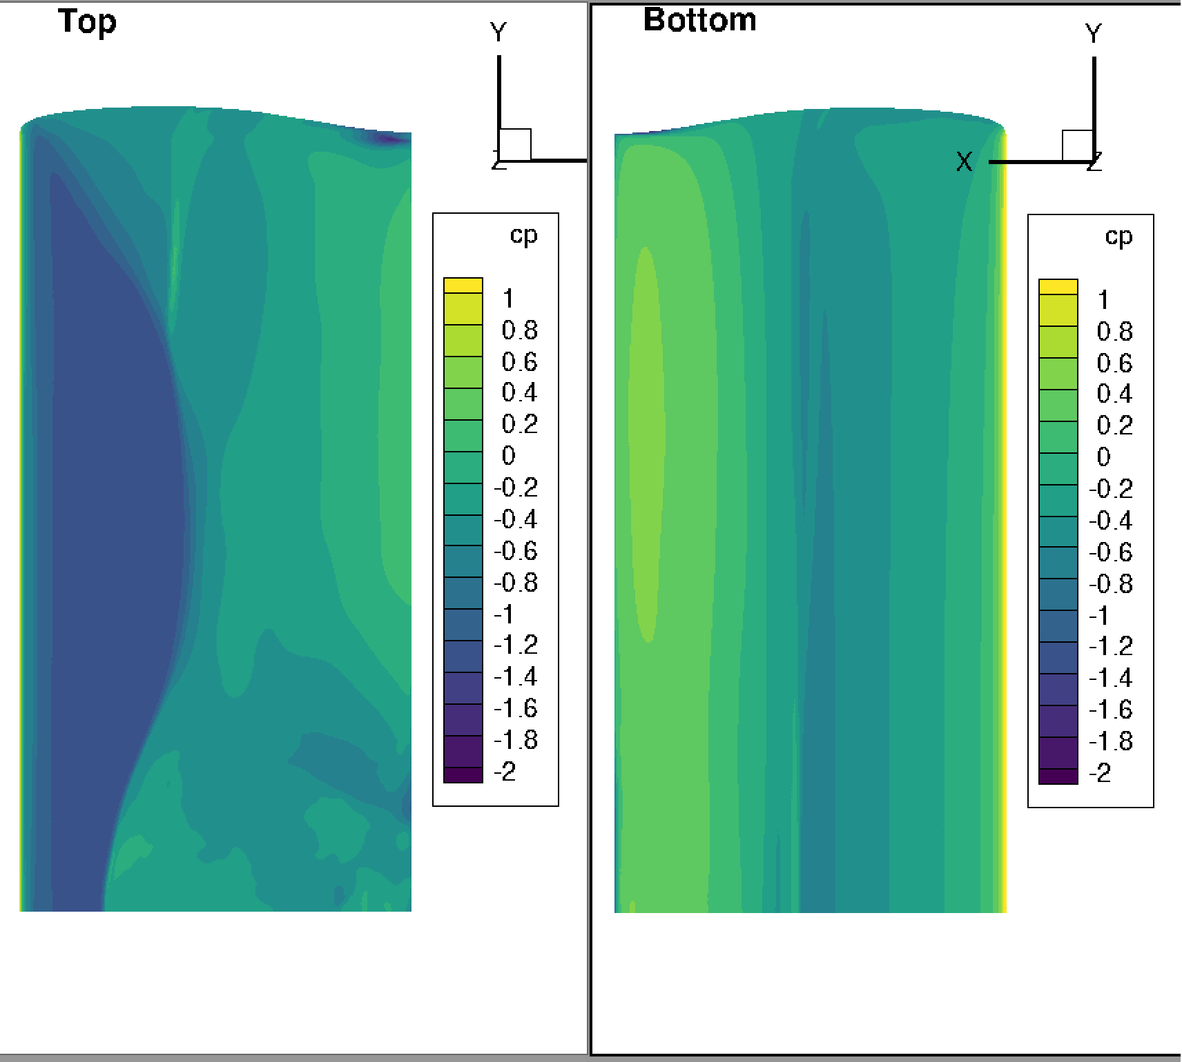
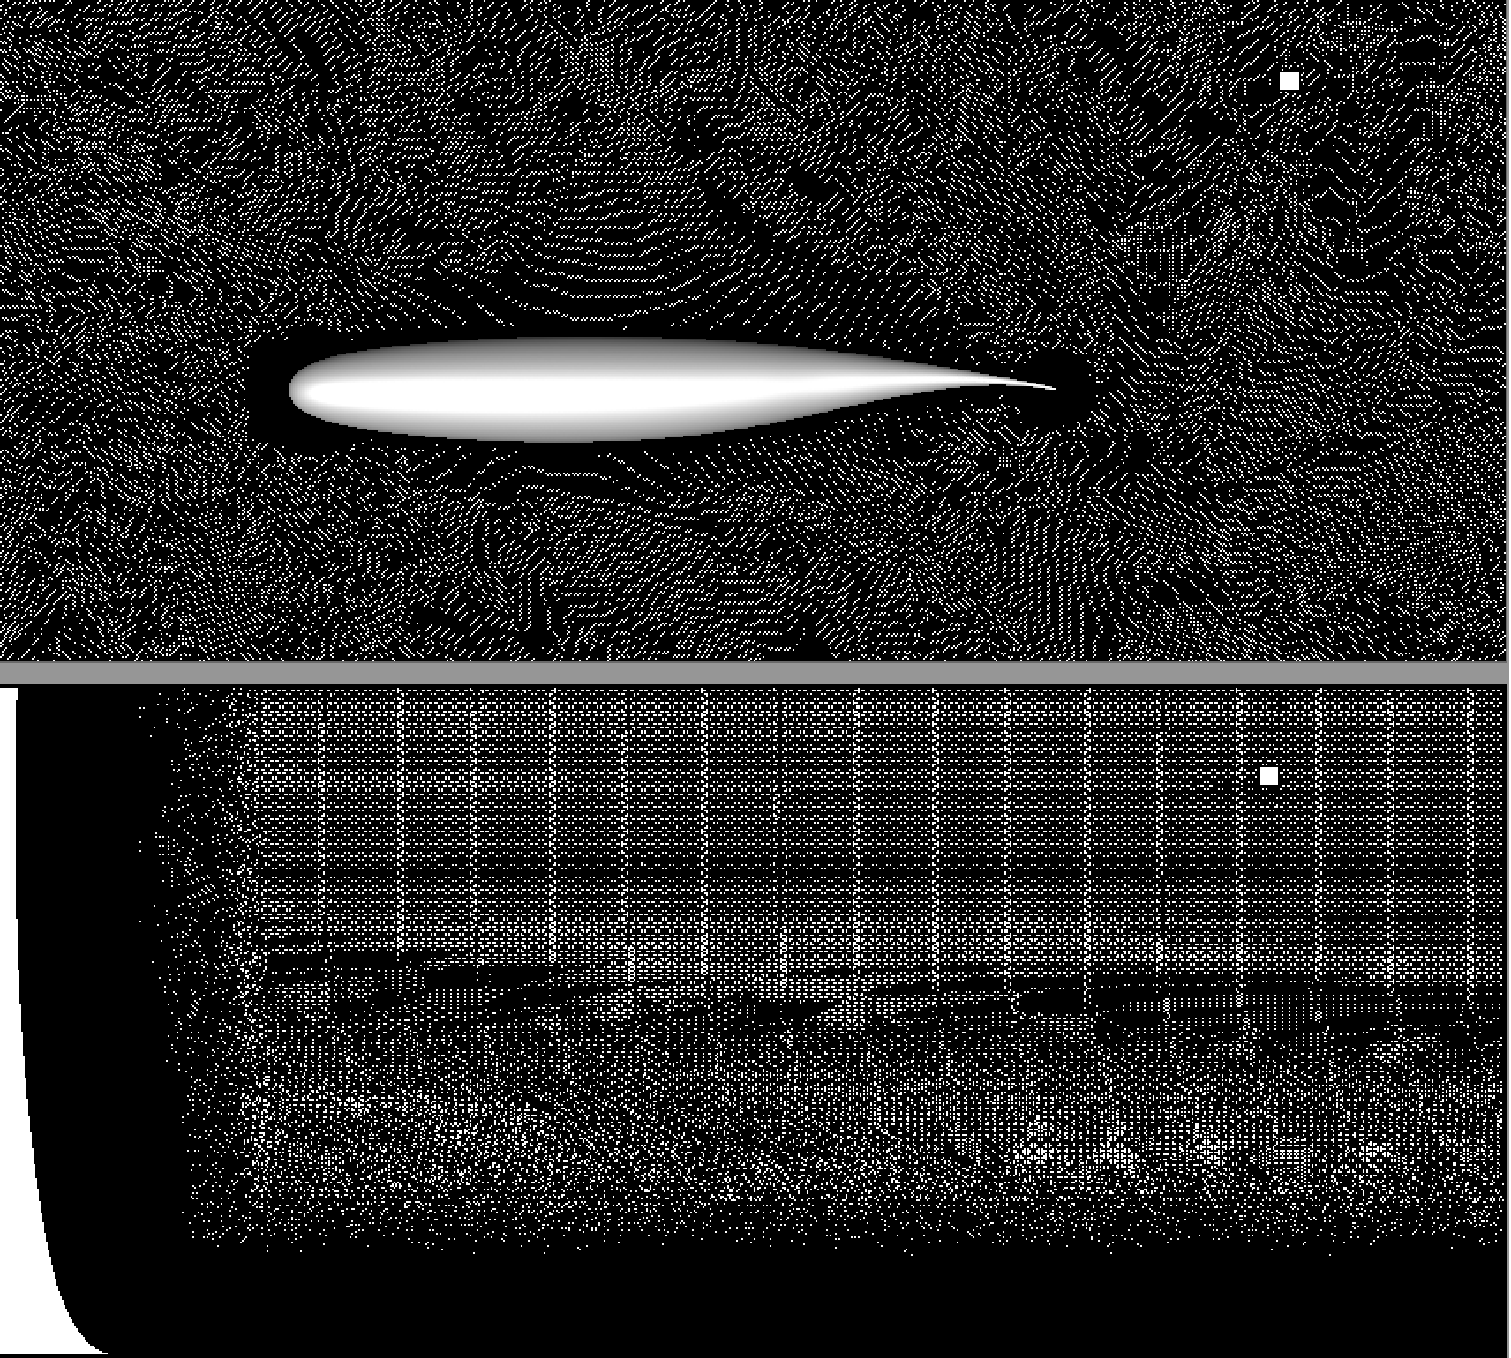
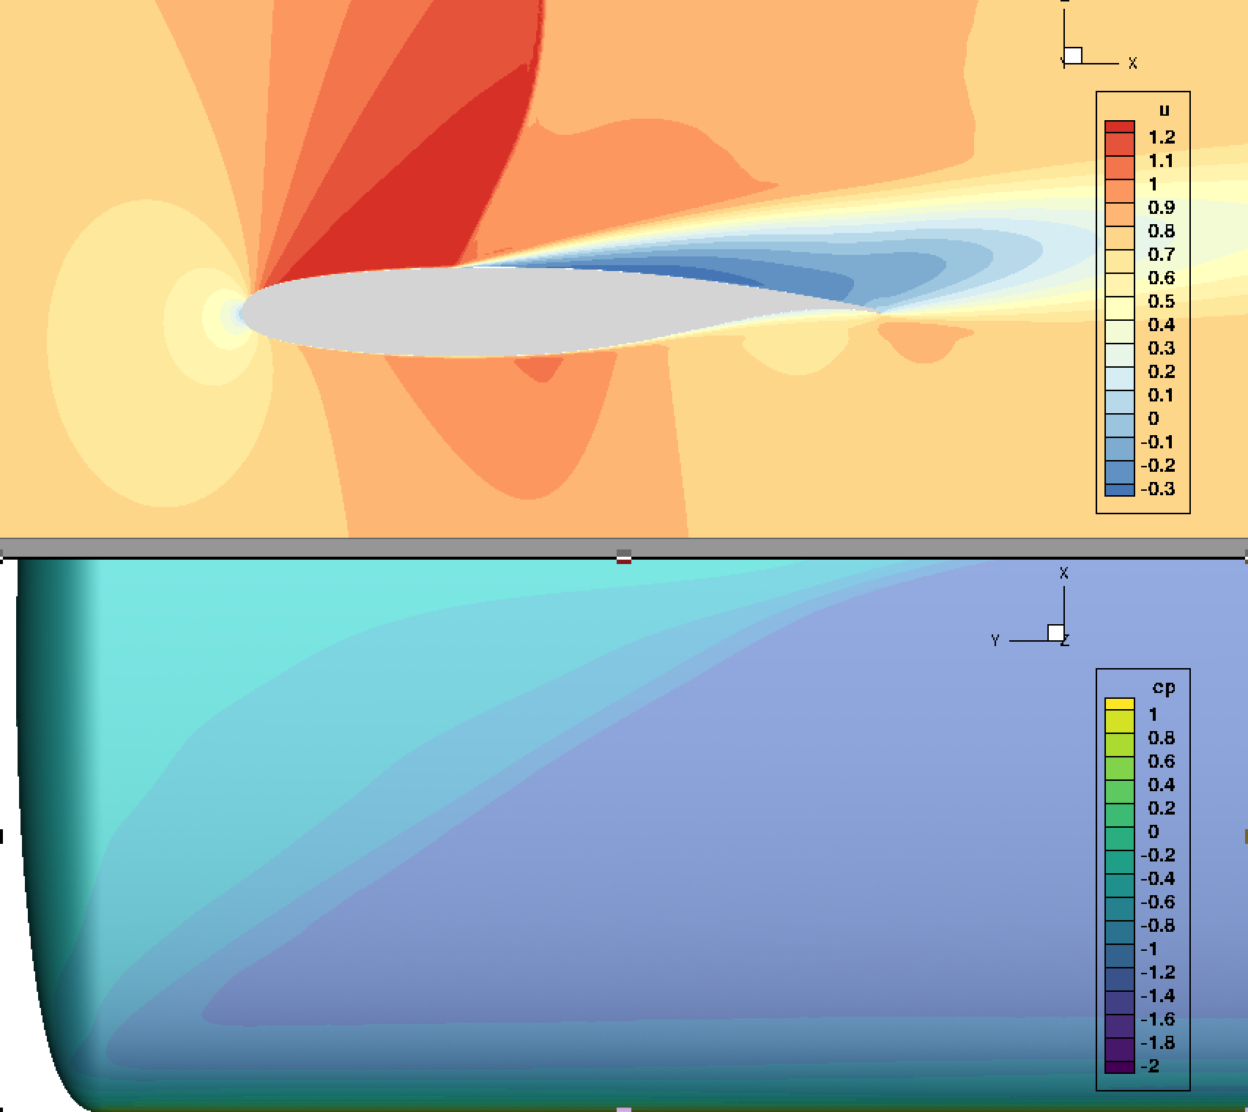
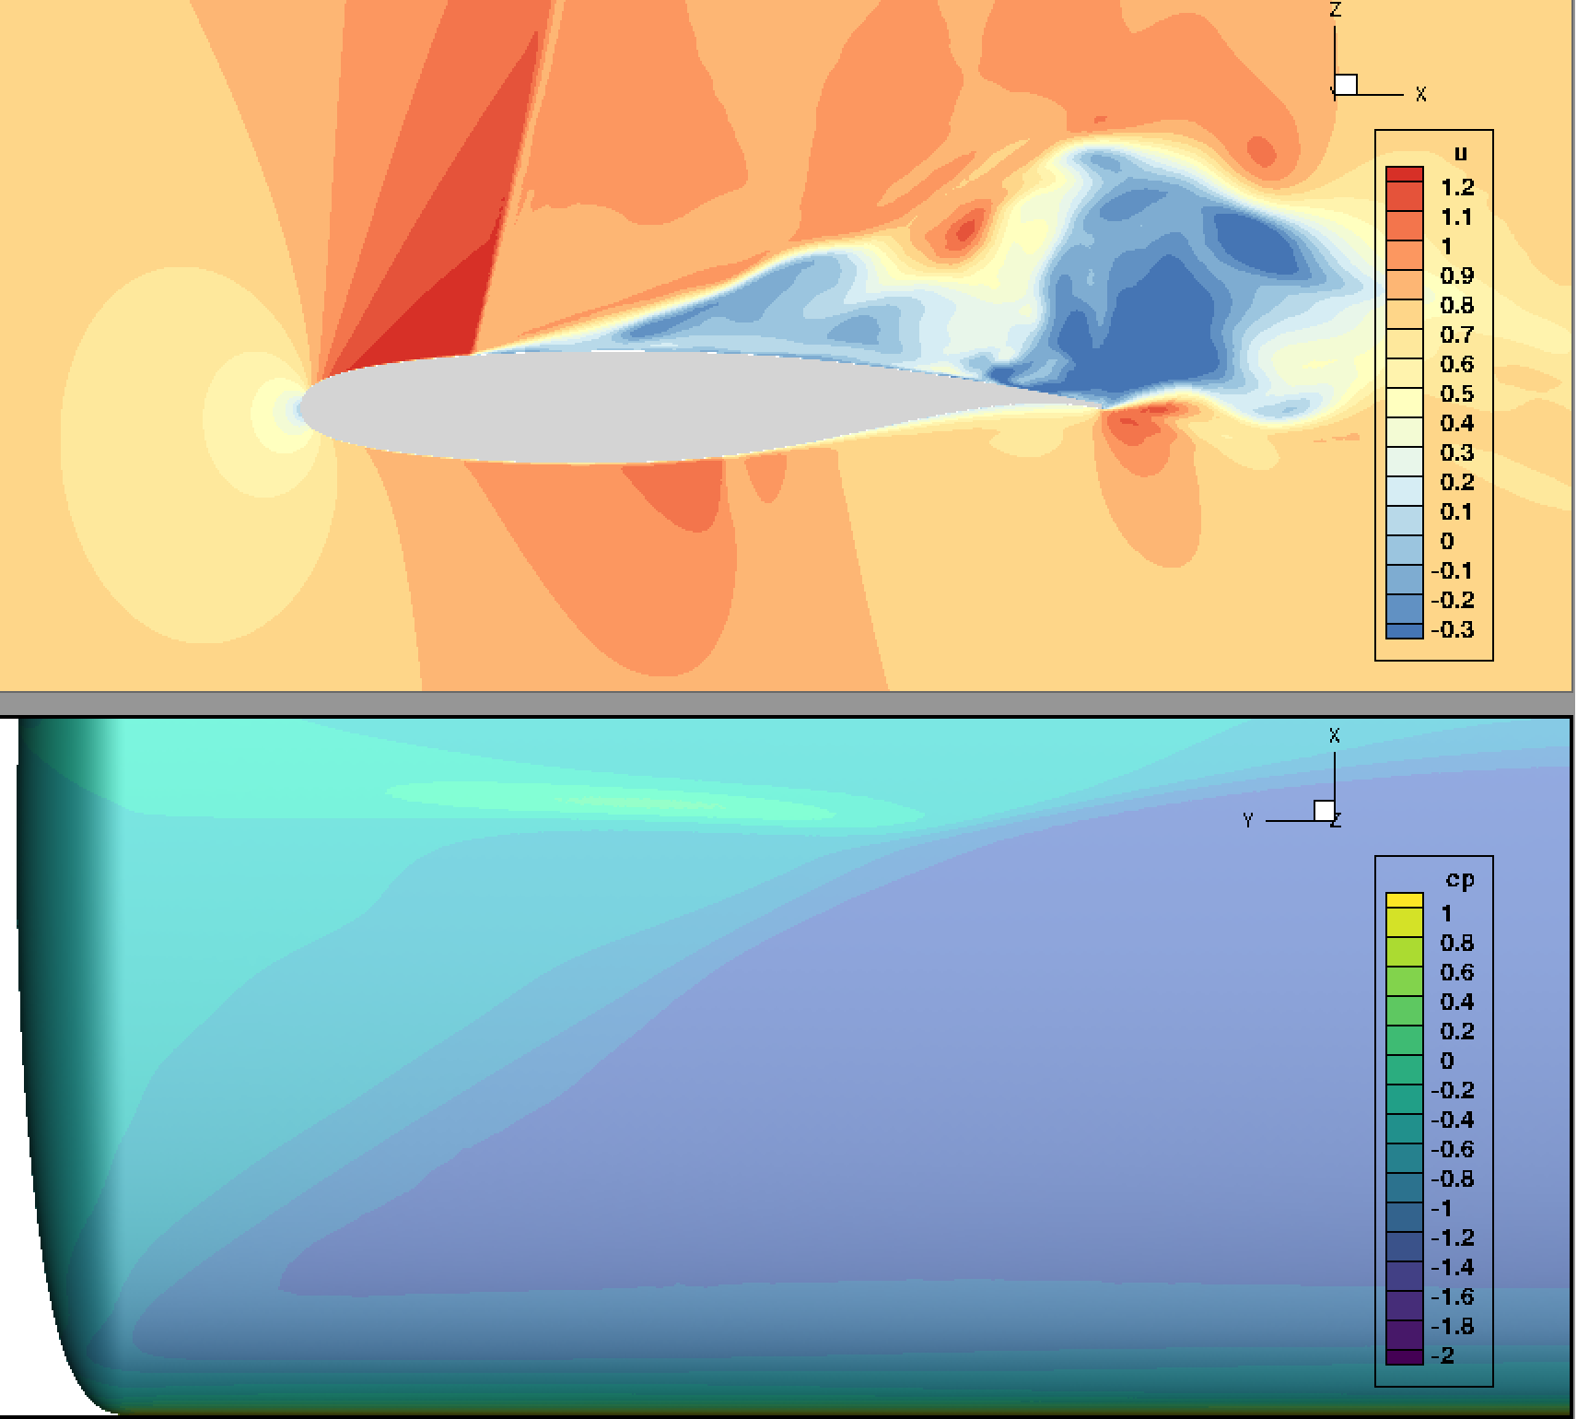
Rigid, BSCW, Mach 0.8, AoA = 5deg, SA turb., no limiter
MeshD (100M) SA
MeshD (100M) DDES

Slide 9
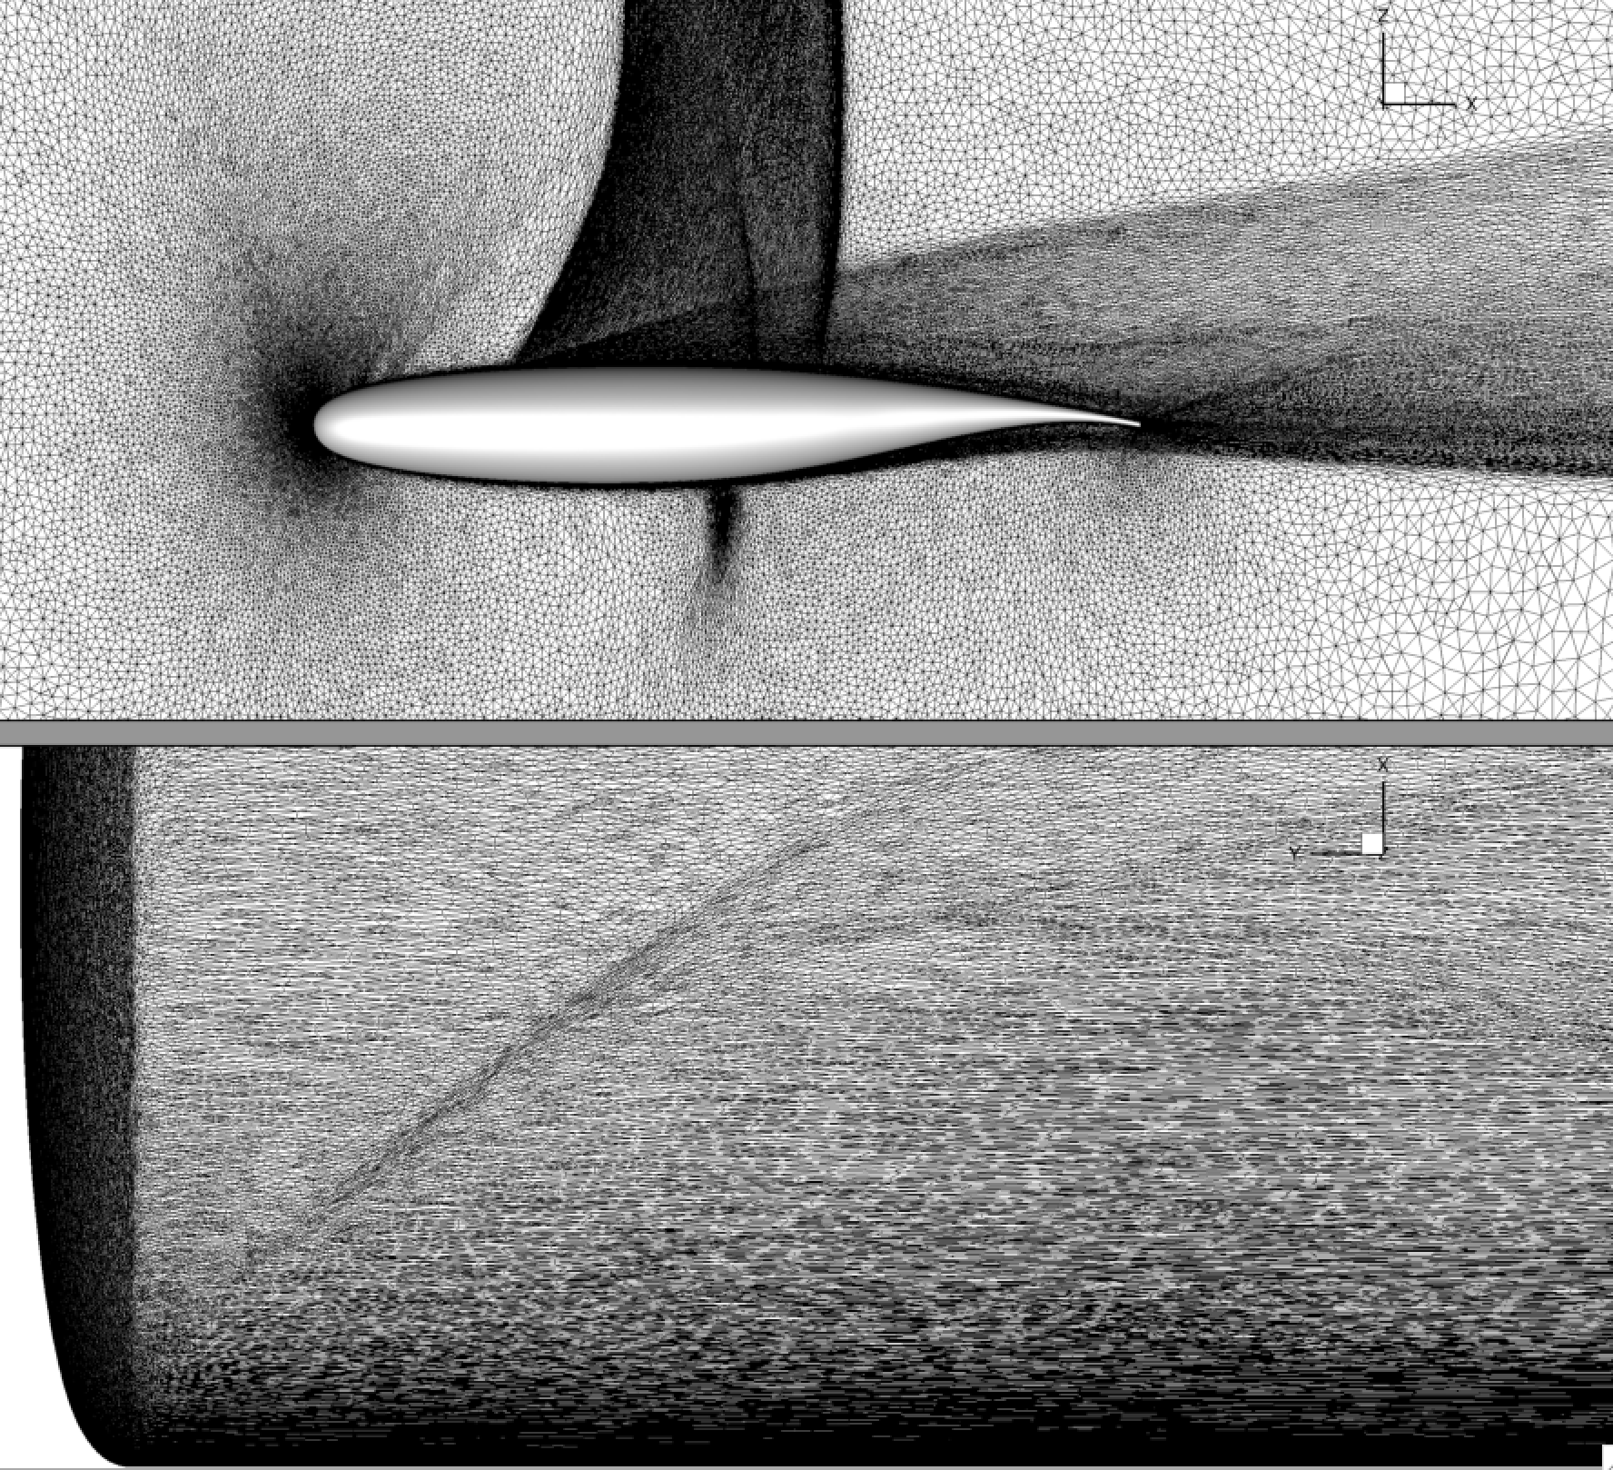
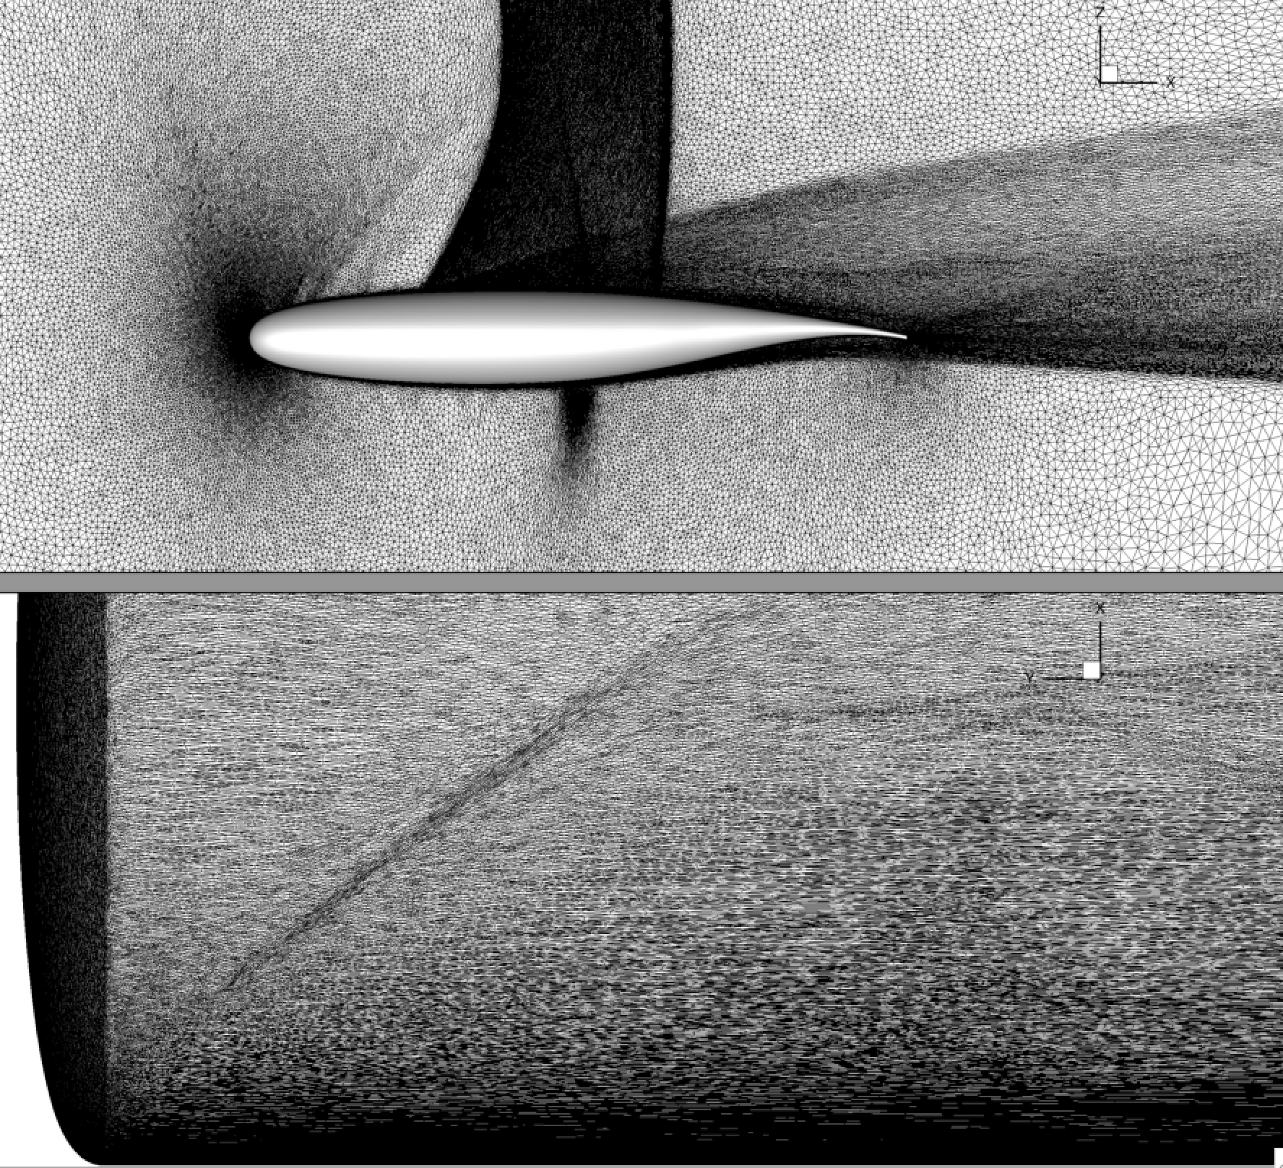
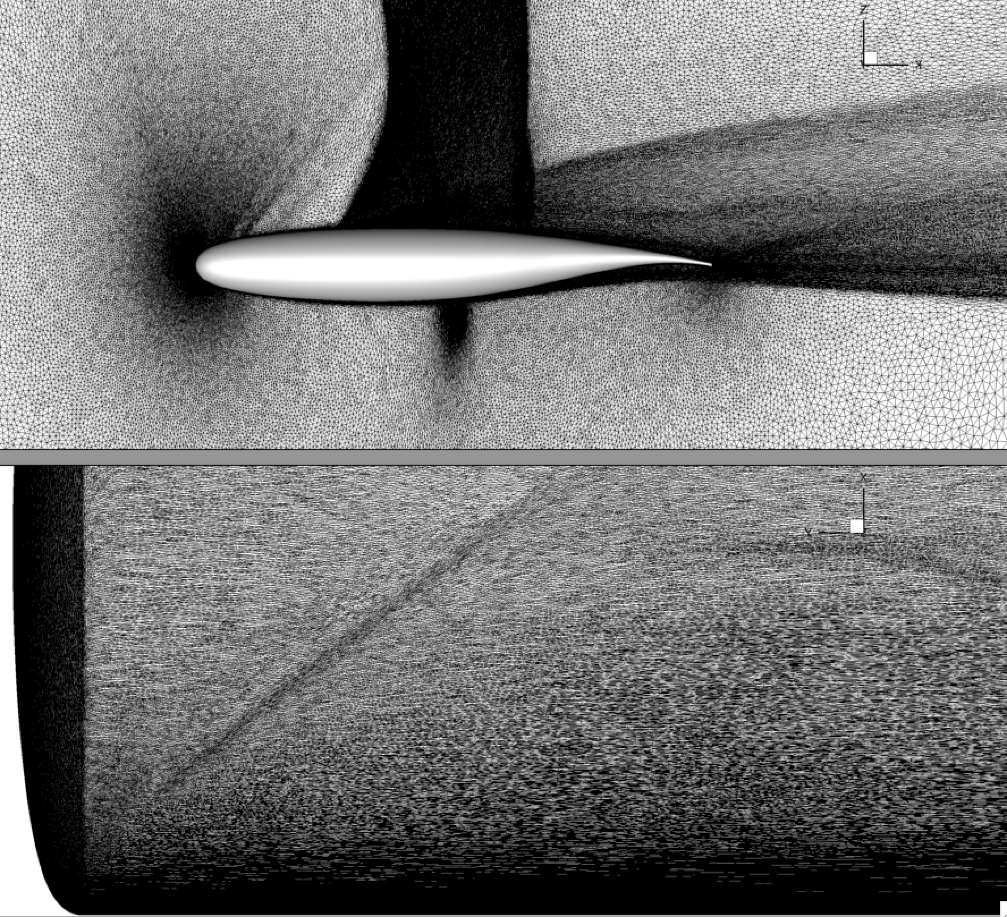
Rigid Steady State, BSCW, Mach 0.8, AoA = 5deg, SA turb., no limiter
Adapt_35 (11M)
Adapt_40 (21M)
Adapt_45 (42M)

Slide 10
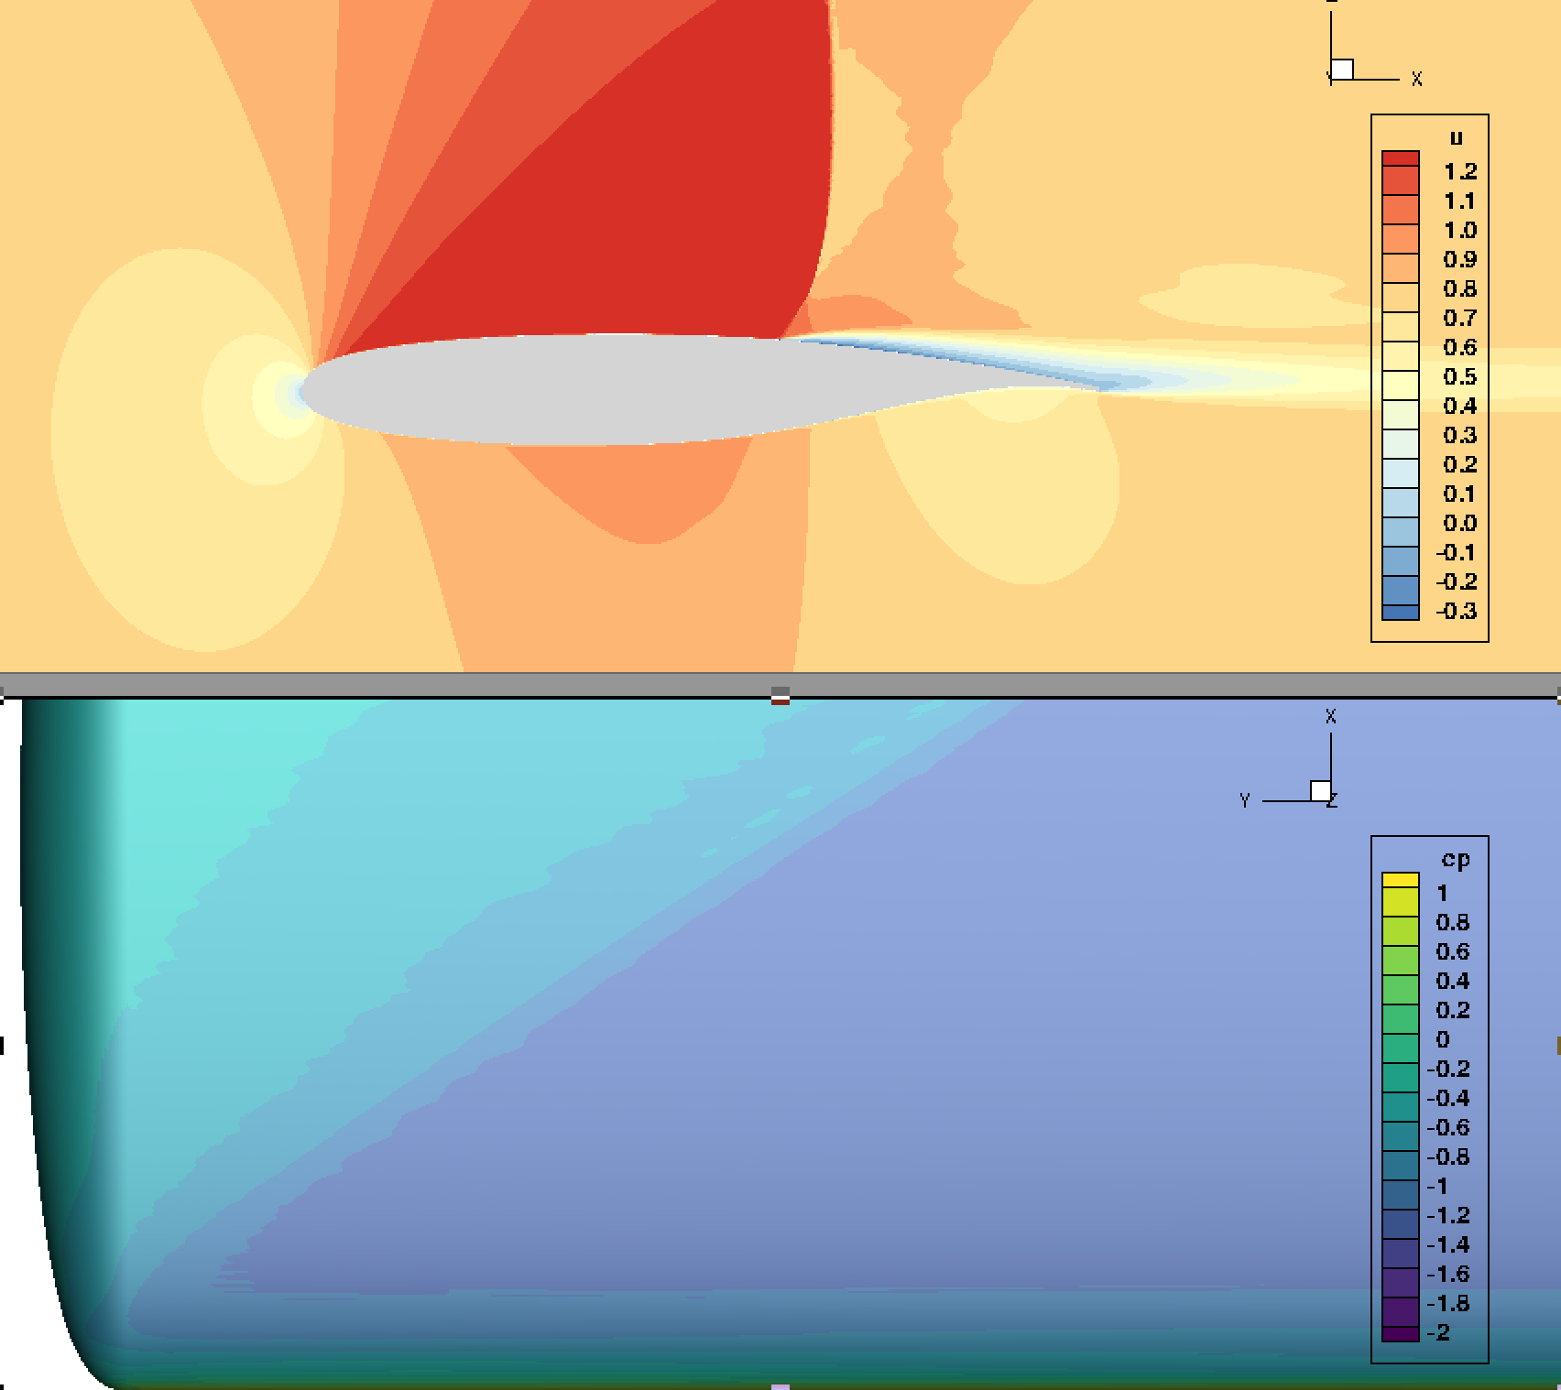
Rigid Steady State, BSCW, Mach 0.8, AoA = 5deg, SA turb., no limiter
AePW Fine (27M)
MeshD (100M)
Adapt_45 (42M)

Slide 11
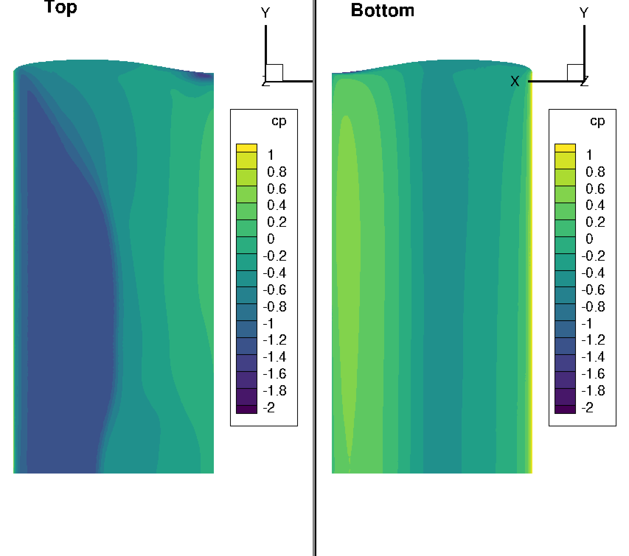
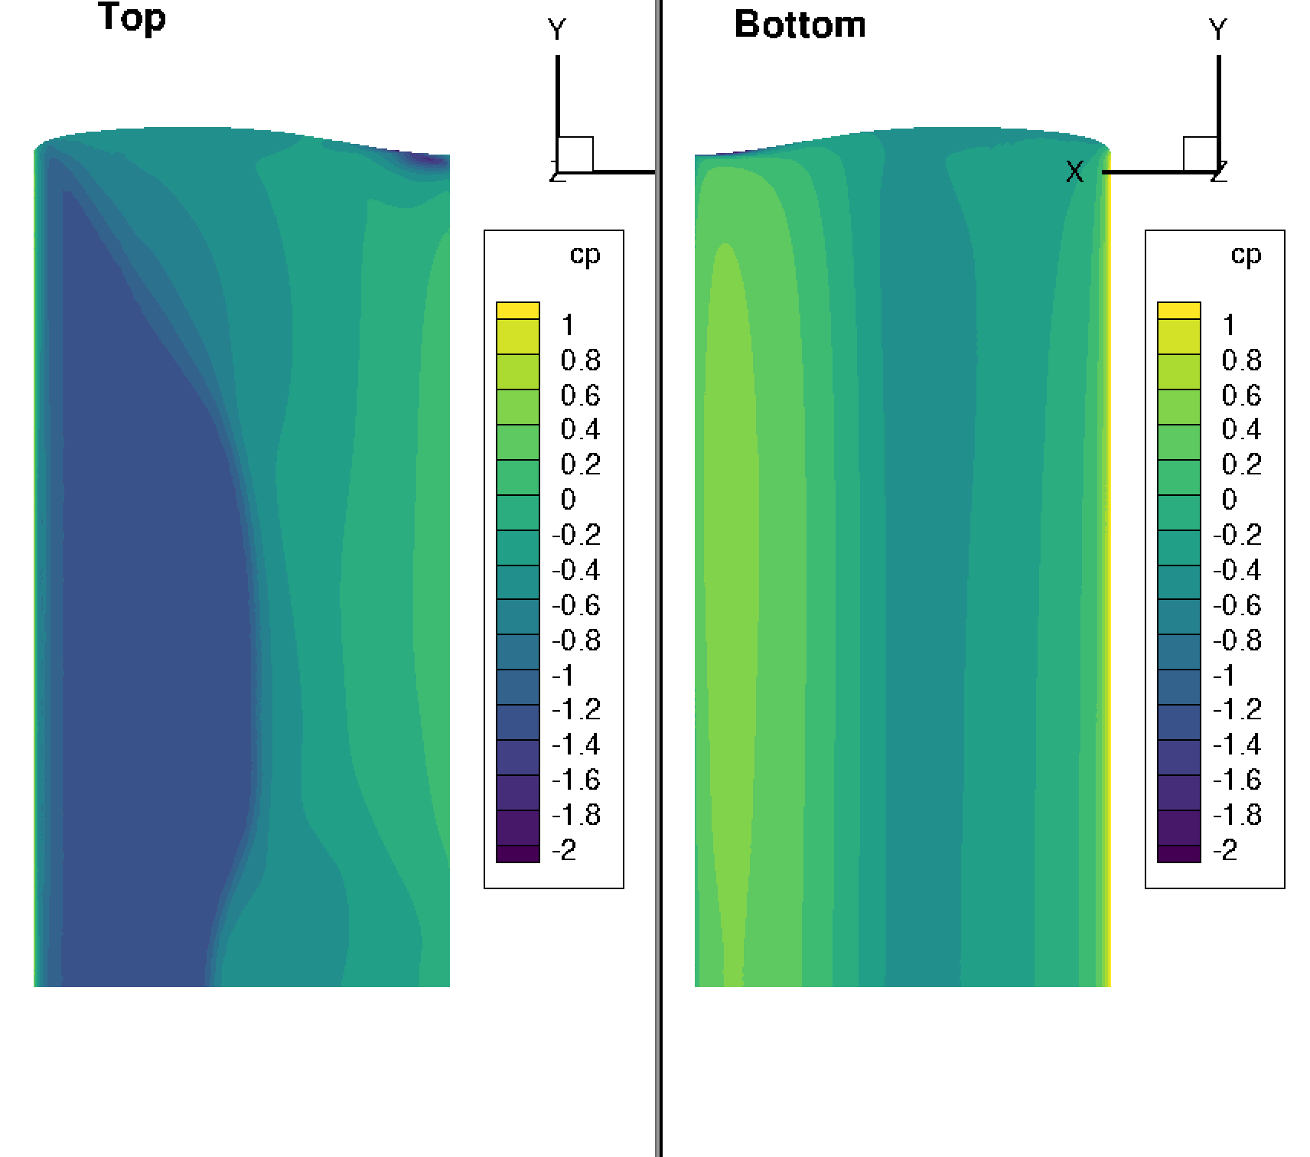
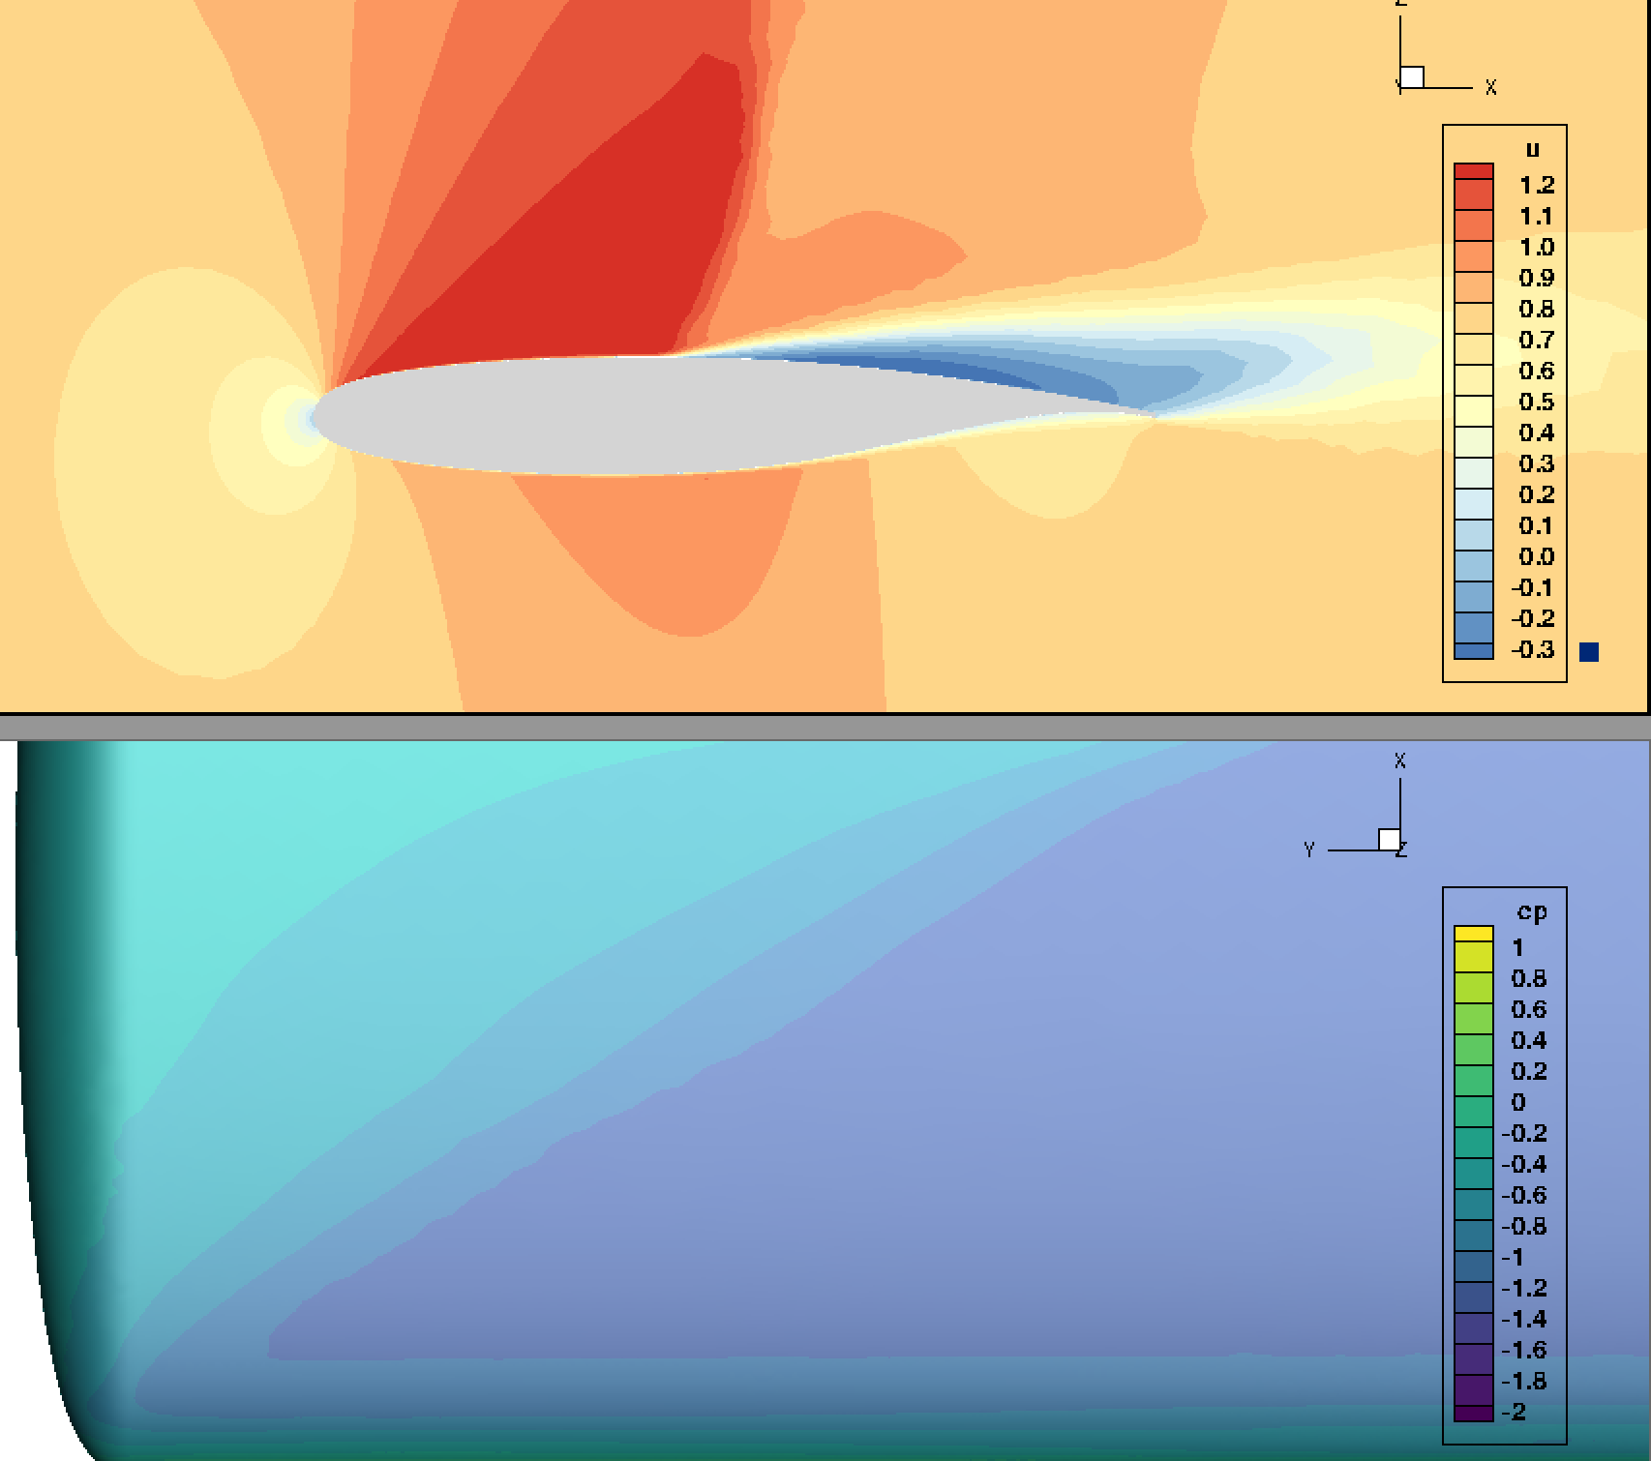
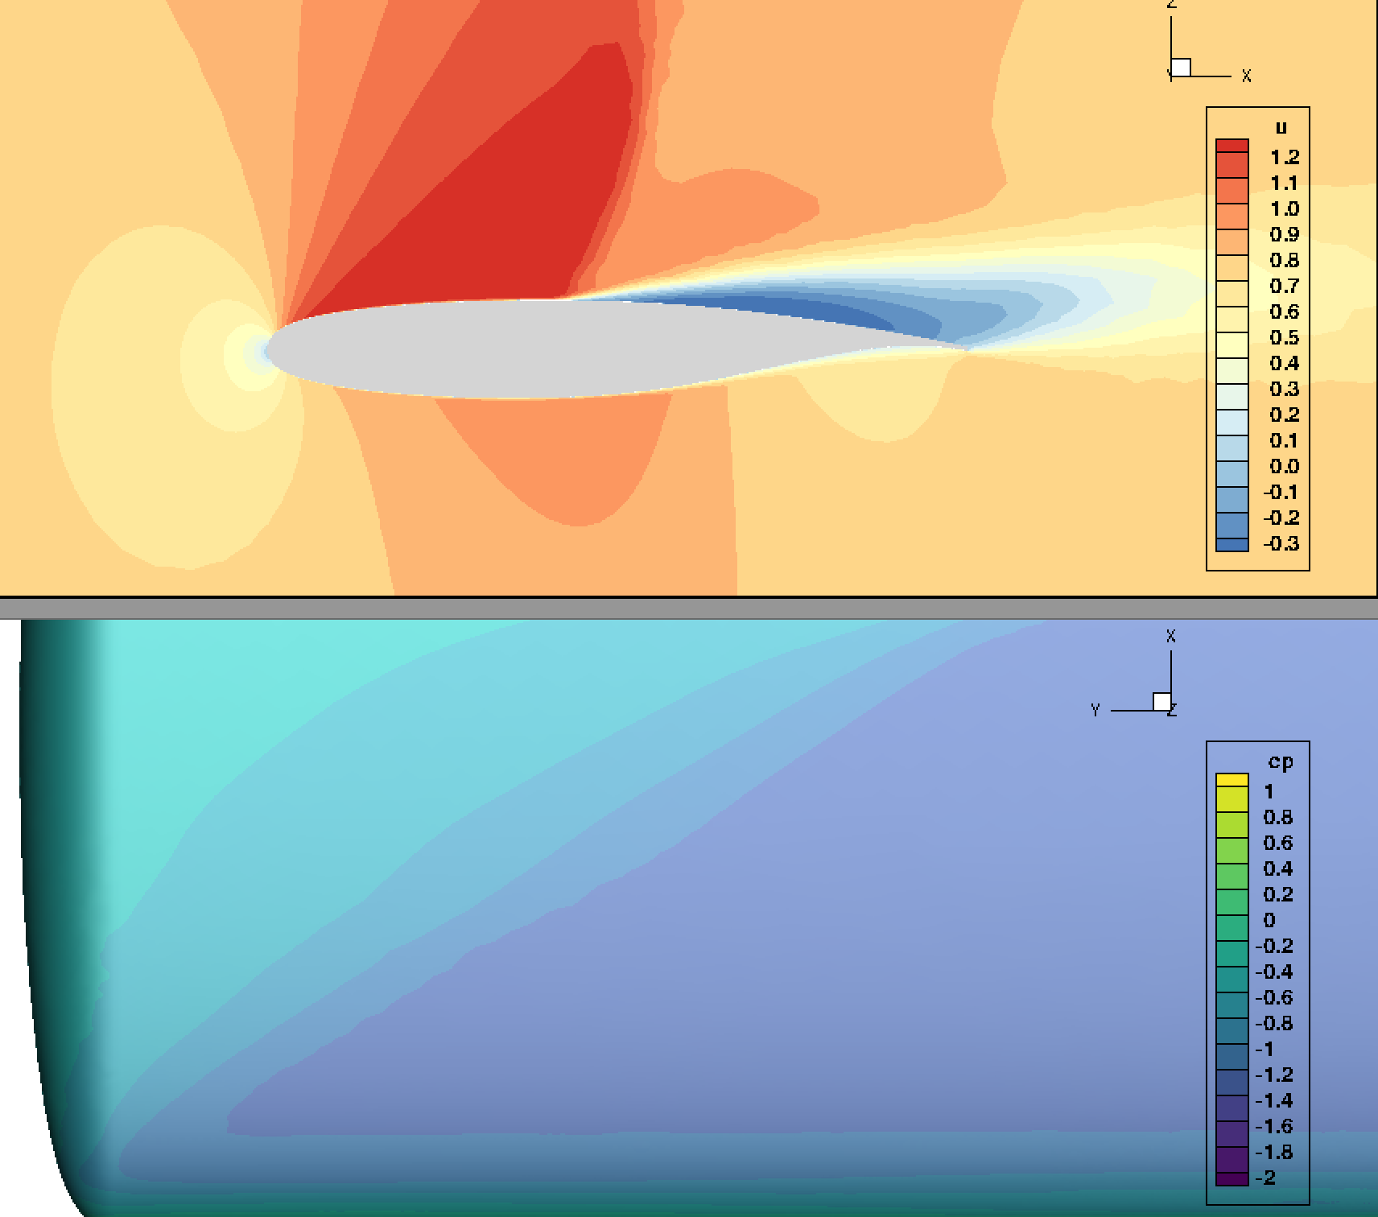
AePW Coarse (3M)
Rigid Steady State, BSCW, Mach 0.8, AoA = 5deg
SA
SA RC QCR Venkat Limiter
SA Venkat Limiter

Slide 12
Mode 2 Response, Mach 0.8, AoA = 5deg, q = 25 psf, SA turbulence model, No limiter
Mesh Resolution | V13.3
 | AePW Mesh | MeshD
Xcoarse | Stable (2M) | Stable (4M)
Coarse | Unstable (3M) | Stable (11M)
Medium | Unstable (9M) | Neutrally Stable (35M)
Fine | Unstable (27M) | SA - Neutrally Stable ? (Crash!) DDES – Unstable (Crash!) (100M)
XFine

Slide 13
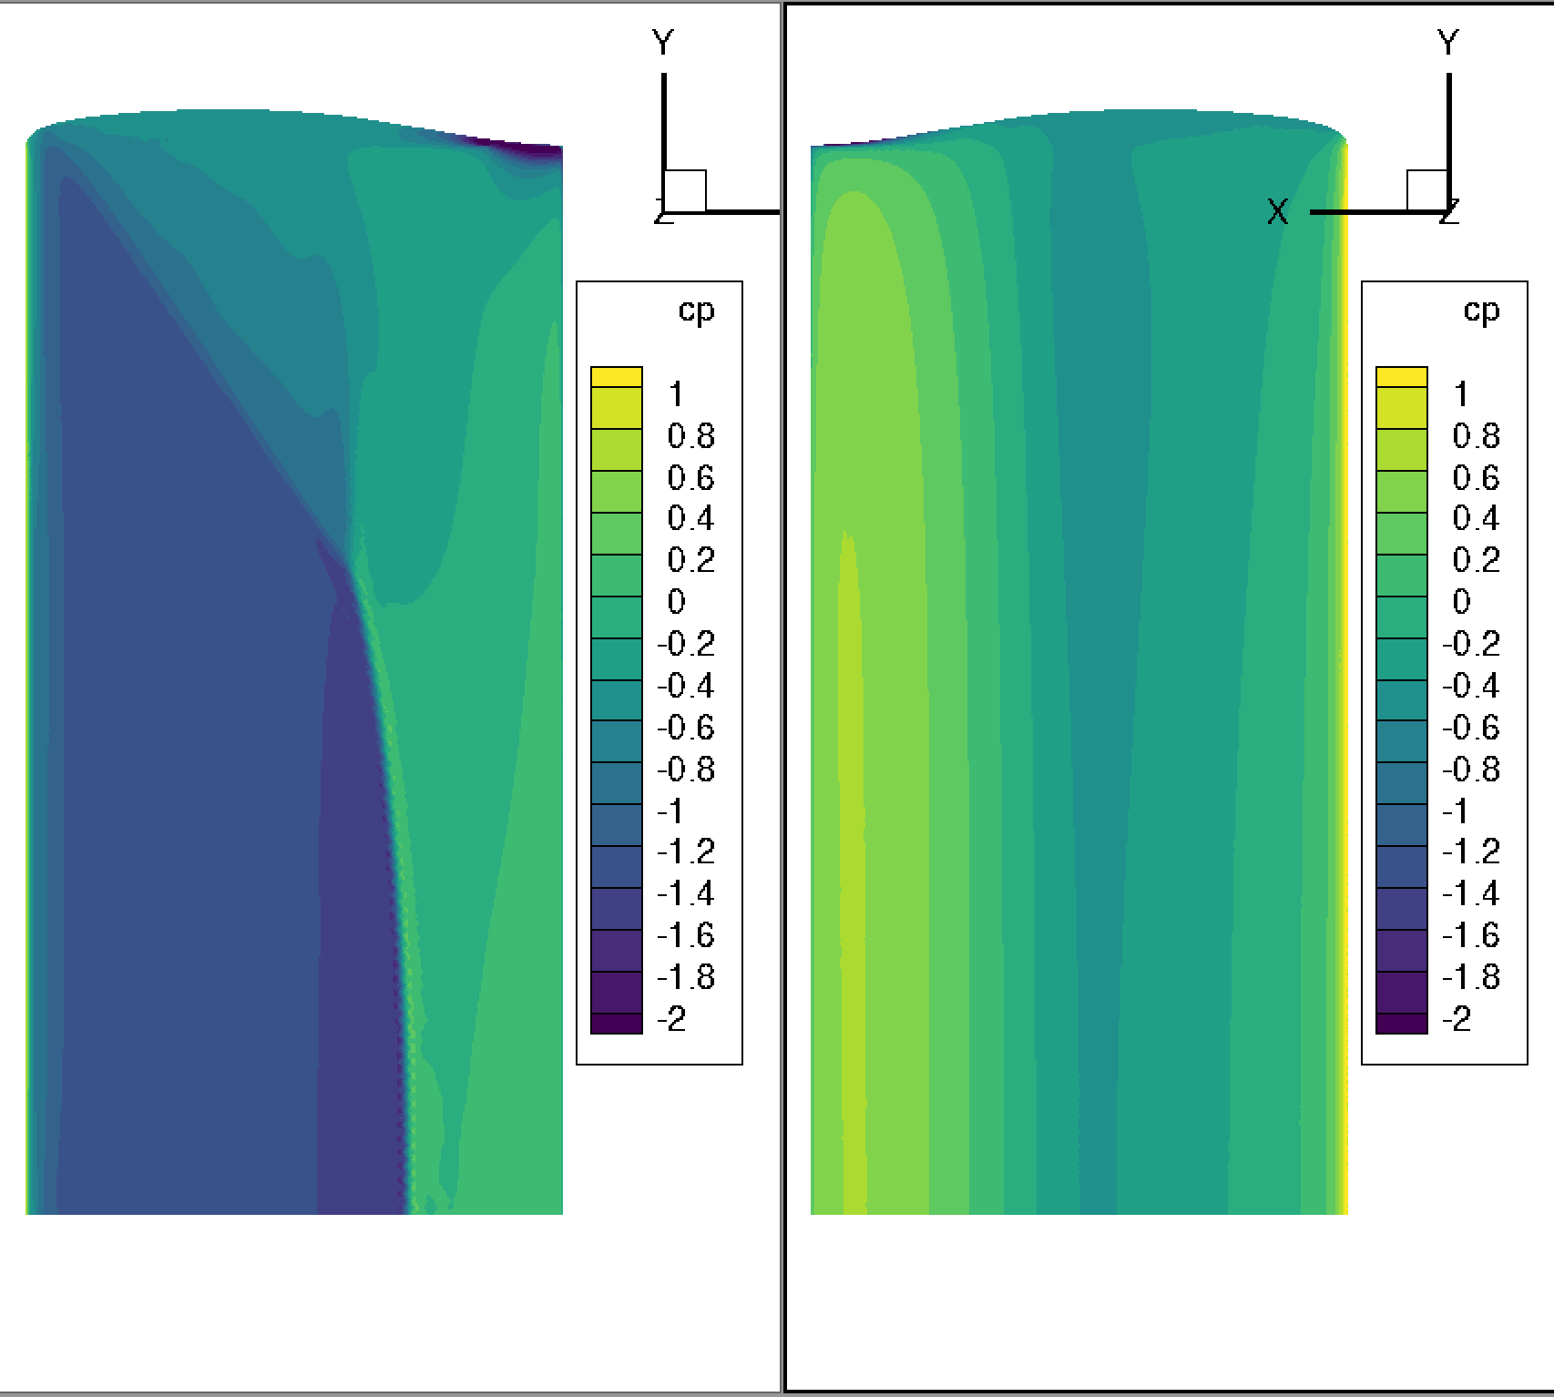
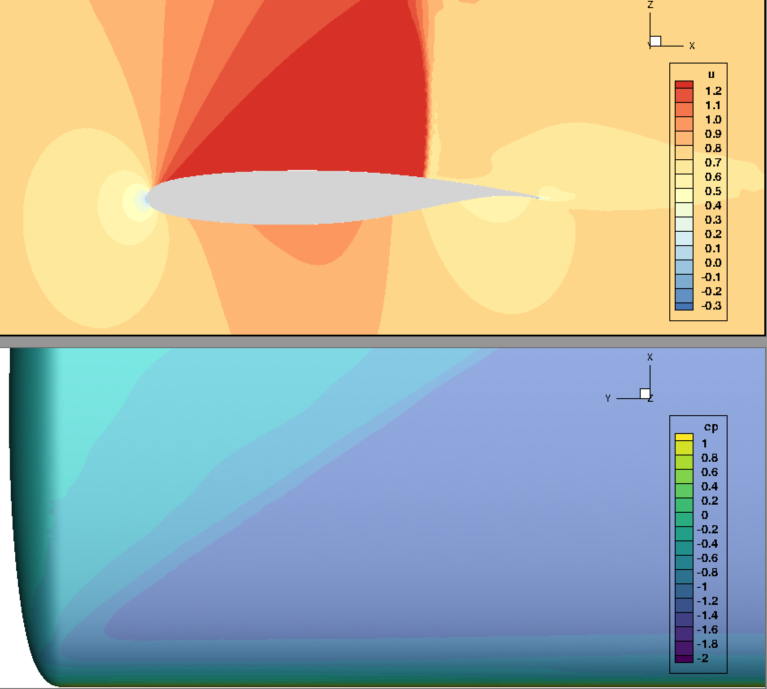
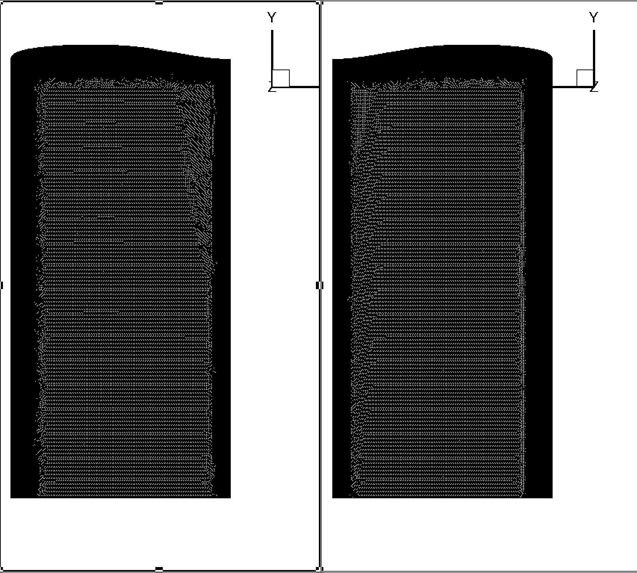
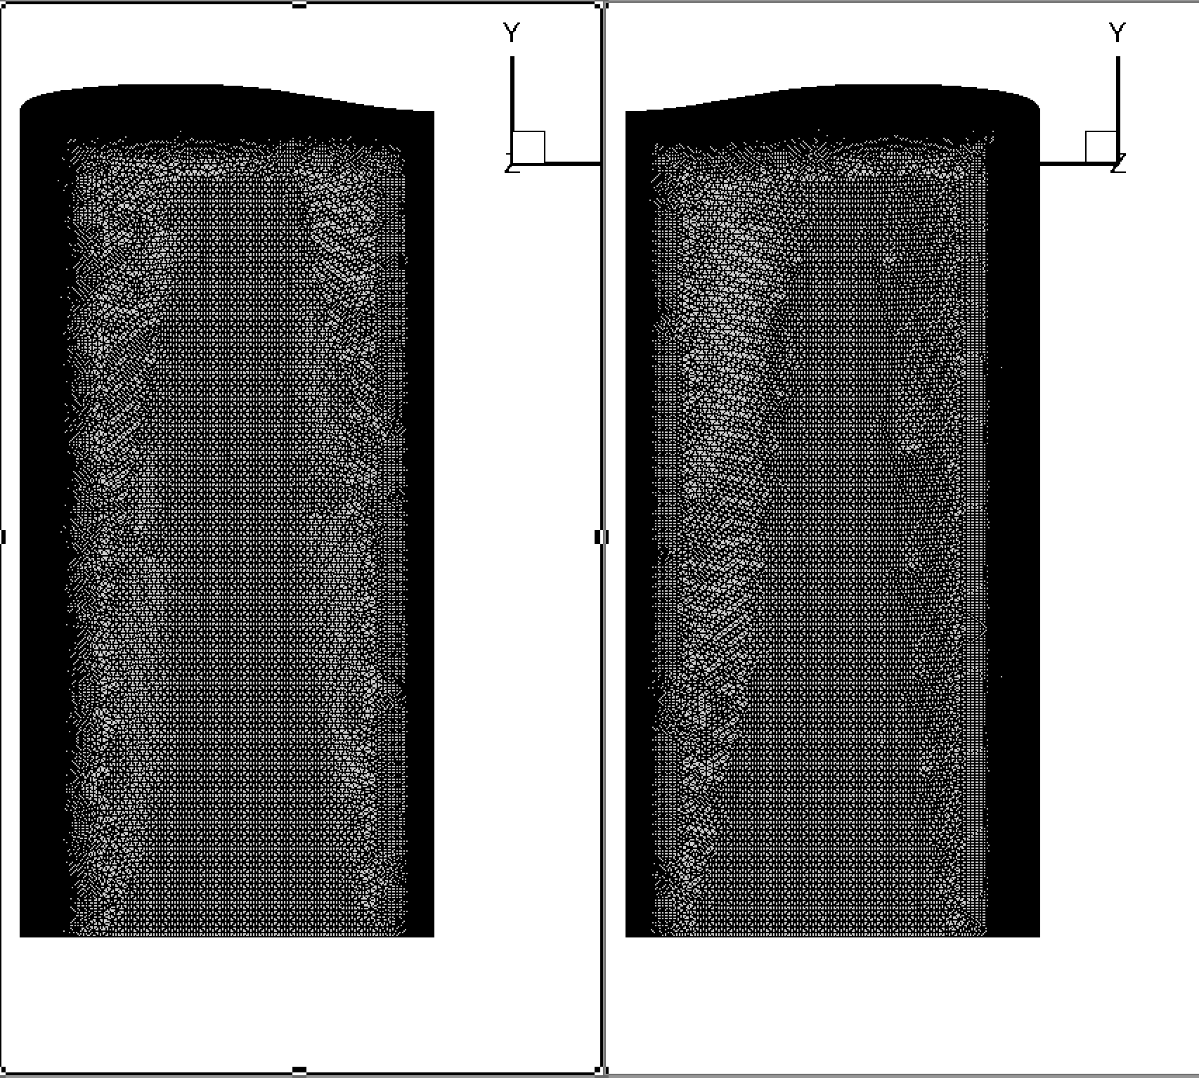


Inviscid Solutions
Coarse Mesh (2.2M)
Medium Mesh (4.9M)

Slide 14
Experimental Data from prior testing

Slide 15
Shock induced separation assessment
Mach | 0.6 | 0.7 |  | 0.8 |  |  | 0.85 | 0.87
 | 170 | 100 | 170 | 100 | 170 | 200 | 200 | 100 | 170
-1 |  |  |  |  |  |  | 1.27 | 1.28 | 1.28
0 |  |  |  |  |  |  | 1.28
1 |  |  |  | 1.21 | 1.21 | 1.22
3 |  | 1.20 | 1.21 | 1.29
5 | 1.07 | 1.29
q (psf)
α⁰
X
Shock-induced separation
Shock-induced separation onset
X
Data unavailable
Number value
Sub-critical, maximum local Mach

Slide 16
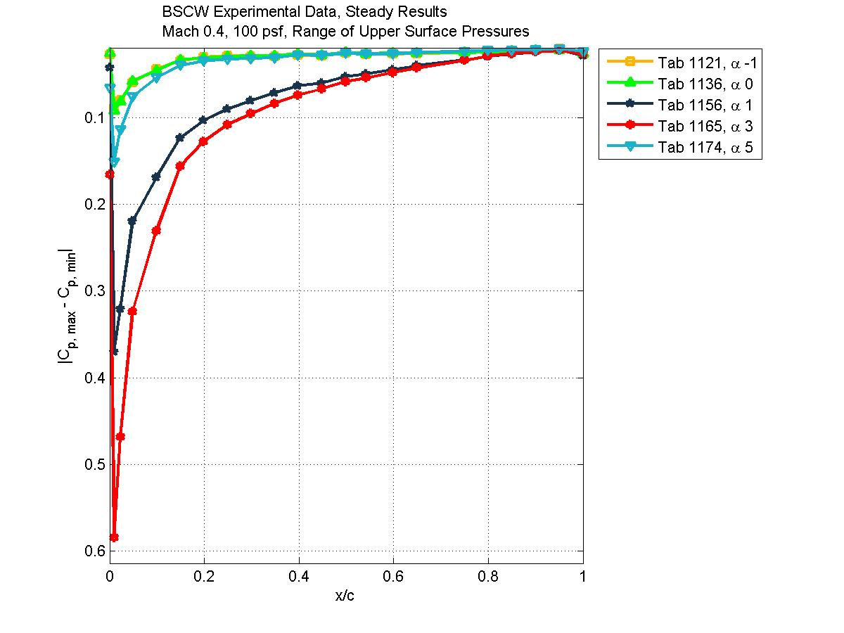
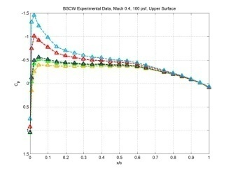
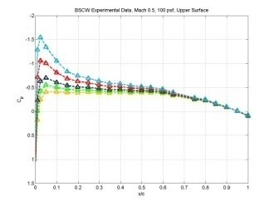
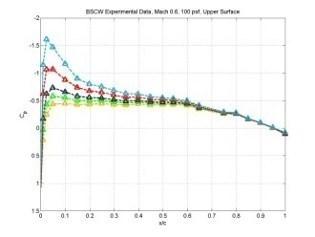
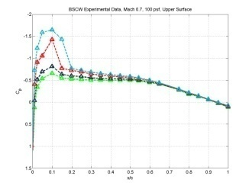
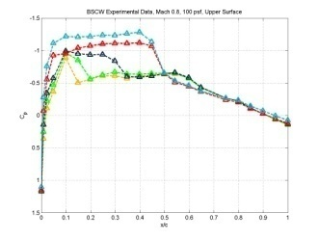
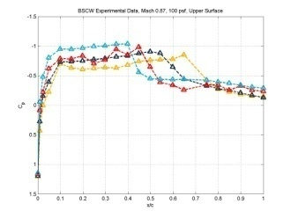
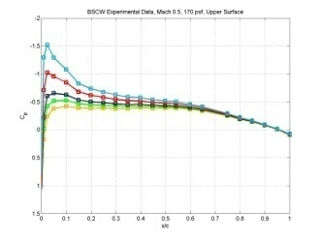
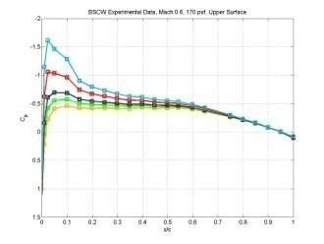
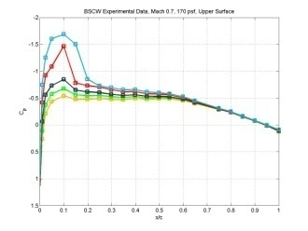
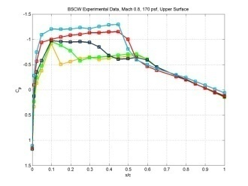
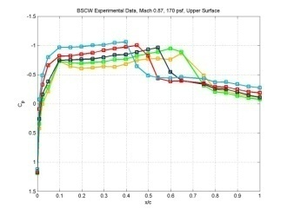
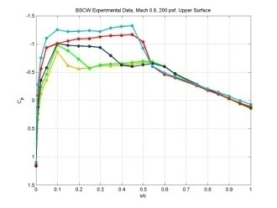
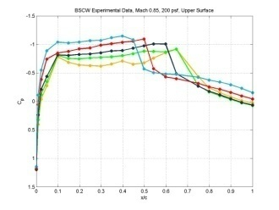
Trailing edge separation assessment:
Mean pressure distribution, Cp, for static data points: UPPER surface
Mach
Dynamic
Pressure
(psf)
0.4
0.5
0.6
0.7
0.8
0.85, 0.87
100
170
200

Slide 17
Trailing edge separation assessment:
Mean pressure distribution, Cp, for static data points: UPPER surface
Mach
Dynamic
Pressure
(psf)
0.4
0.5
0.6
0.7
0.8
0.85, 0.87
100
Attached
Attached
Attached
Attached
Attached
Separated
Attached
Attached
Attached
Attached
Attached
Separated
Attached
Attached
Attached
Attached
Separated
170
Attached
Attached
Attached
Separated
Separated
TE pressure value criterion
200
Attached
Separated
TE pressure aoa variation criterion
Separated
Separated

